Slide 1

The Premature Infant Oral Motor Intervention:
Launching PIOMI in Turkey
Background, Evidence, Training
Brenda Lessen Knoll, PhD, RN
Train the Trainer
Nov 20, 2020

Slide 2

Objectives:
Discuss the background of oral motor therapy for
preterm infants in the NICU.
2. Discuss the evidence on PIOMI outcomes.
3. List the positive feeding outcomes after PIOMI.
4. Demonstrate how to apply PIOMI to the preterm infant.
5. Discuss development of unit protocols to implement PIOMI in the NICU.
6. Discuss future research opportunities/needs for PIOMI.
7. Evaluate the training session.

Slide 3
CEU
Table:
Objectives | Content | Method | Time Frame
The participants will be able to: |  | Virtual via synchronous ZOOM with individual live frames visible for return demonstrations. | Minutes
Discuss the background of oral motor therapy for preterm infants in the NICU. | Background/history on oral motor therapy in the preterm infants Introduction to PIOMI | Discussion Powerpoint www.PIOMI.com tour | 20
Discuss the evidence on PIOMI outcomes. | Feeding metrics Length of hospital stay PIOMI pilot study in 2011 Subsequent RCTs specifically on PIOMI Systematic Reviews and Meta-Analyses including PIOMI | Discussion Powerpoint Poster Handout of Reference List | 20
List the positive feeding outcomes after PIOMI. | Feeding metrics Sucking metrics Length of hospital stay Follow-up studies | Powerpoint Systematic Review Poster | 20
Demonstrate how to apply PIOMI to the preterm infant. | 8 step Tool 8 step Parent Version Quick Reference Guides Reliability Rating Tool Eligible infants Positioning Application of PIOMI: Technique Order Timing | Video (13 mins) Handouts: All Tools Demonstration Practice Session Return Demonstration | 60
Discuss development of unit protocols to implement PIOMI in the NICU. | Interdisciplinary Roles Training for PIOMI Manager Educator IT Applying PIOMI Therapist RN Parent Timing Frequency (#/day) Duration (how many days) Documentation needs | Powerpoint Poster Discussion Q&A | 30
Discuss future research opportunities/needs for PIOMI. | Research vs QI projects Variables needed Consultation | Discussion Q&A | 20
Evaluate the training session. | Evaluation of: PIOMI video Handouts/Tools Practice Session Demo/Return Demo Instructor Virtual Conference Overall | Paper evaluation tool (optional anonymity) Verbal discussion/Feedback | 10

Slide 4
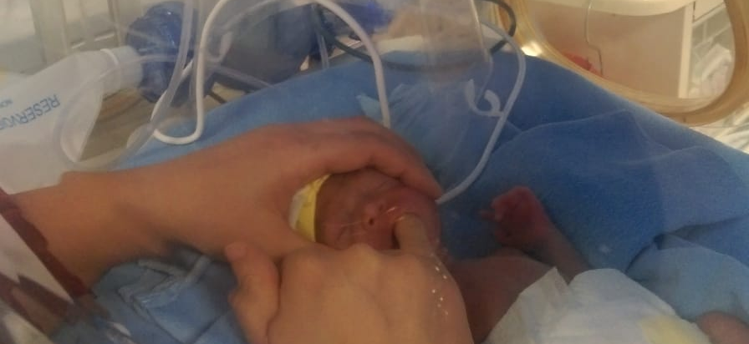
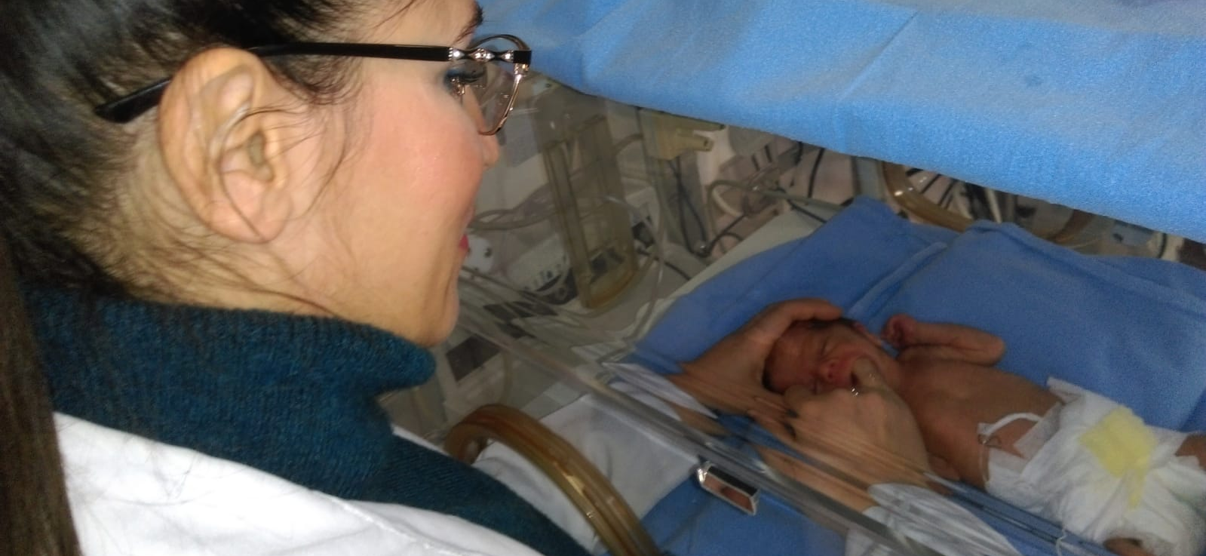
Oral motor therapy in the NICU
Therapy through several disciplines:
Occupational Therapists (OT)
Physical Therapists (PT)
Speech Language Pathologists (SLP)
Neonatal Therapy* is the art and science of integrating typical development of the infant and family into the environment of the NICU (NANT.com).
promotes optimal long-term developmental outcomes
nurtures infant-parent relationships
addresses neurobehavioral, neuromotor, neuroendocrine, musculoskeletal, sensory, and psychosocial neurodevelopmental systems.
*This definition was created by the NANT Professional Collaborative (NPC).

Slide 5
PIOMI→TO DEVELOP FEEDING SKILLS
Therapy through several disciplines:
Occupational Therapists (OT)
Physical Therapists (PT)
Speech Language Pathologists (SLP)
  RNs
  Lactation Consultants
  Child Development Specialists
  Parents
Neonatal Therapy* is the art and science of integrating typical development of the infant and family into the environment of the NICU (NANT.com).
promotes optimal long-term developmental outcomes
nurtures infant-parent relationships
addresses neurobehavioral, neuromotor, neuroendocrine, musculoskeletal, sensory, and psychosocial neurodevelopmental systems.
*This definition was created by the NANT Professional Collaborative (NPC).

Slide 6
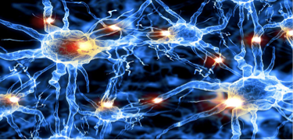
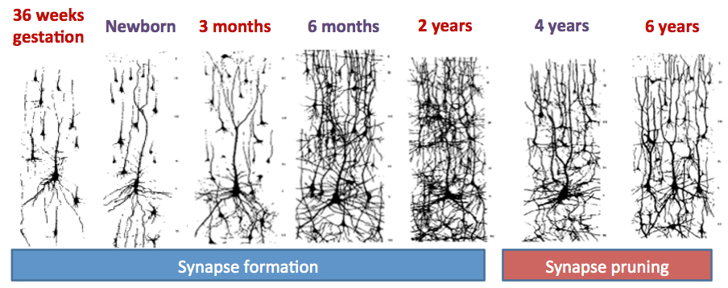
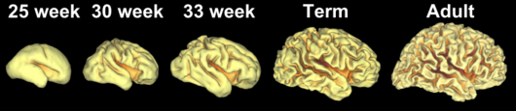
Rapidly developing brain
Neurogenesis- new neurons developing
Neuroplasticity-wiring and re-wiring pathways between those neurons

Slide 7
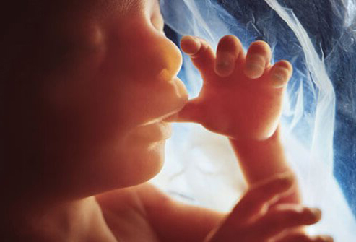
Oral experience in the womb - PERFECT
Oral motor sensory experiences in the womb develop the skills needed for feeding:
Mouth full of amniotic fluid
Tongue ROM and strength against resistance
  Tactile: Tongue touching palate, inside of cheeks, gums & lips
Cheek strength against resistance
Jaw opening and closing with gentle resistance
Sucking & Swallowing
Brain registers PLEASURE
Neuronal pathways rapidly grow as a result of each sensation (fetal development is a point of high neurogenesis and plasticity)
We are GROWING & WIRING THEIR BRAIN

Slide 8
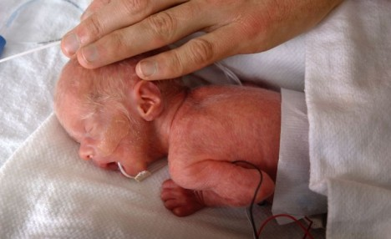

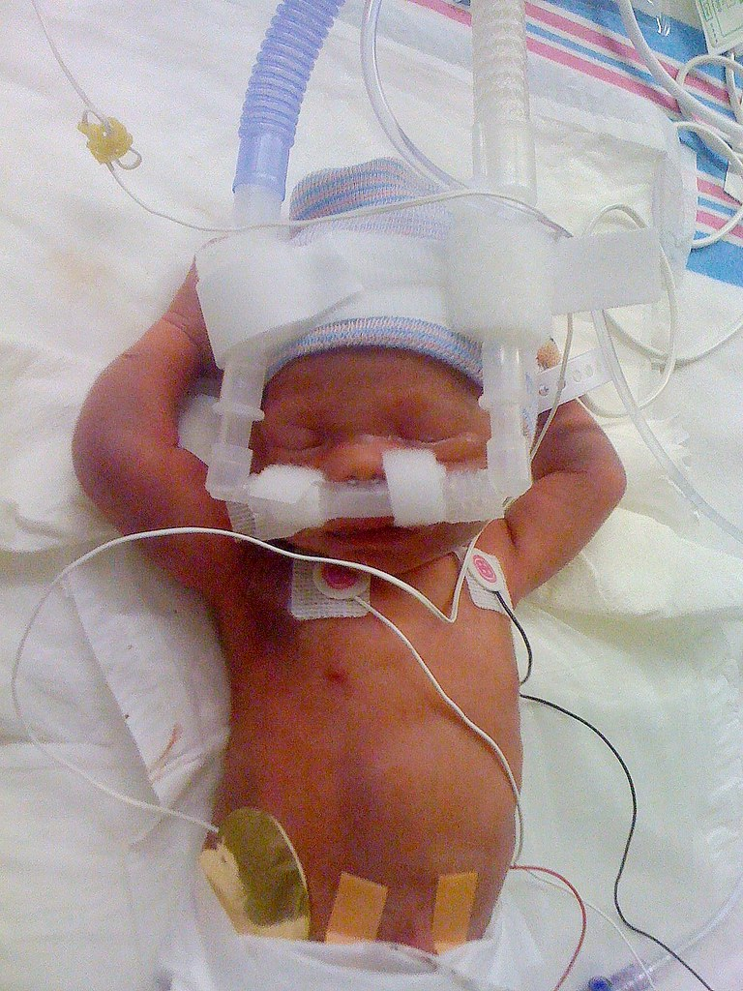
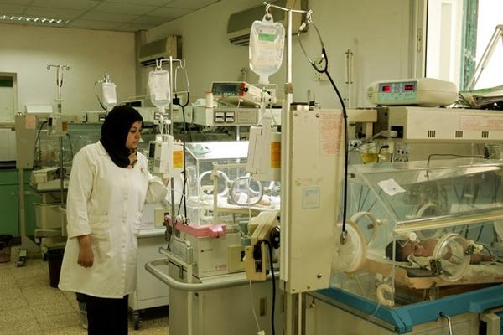

Oral experience in a NICU vs in the womb
Oral motor sensory experiences in a NICU when born preterm DETER feeding:
Mouth dry and hung open
Tongue dry and lying still
Cheeks lax and still
No movement against resistance of fluid
Little pleasurable contact
of tongue with palate, inside of cheeks, gums or lips
Negative oral experiences: intubation, feeding tube, suction, dry airflow, etc.
Neuronal pathways grow as a result of each sensation (fetal development is a point of high neurogenesis and plasticity)
We are GROWING & WIRING THEIR BRAIN

Slide 9
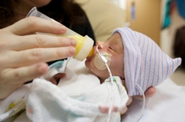
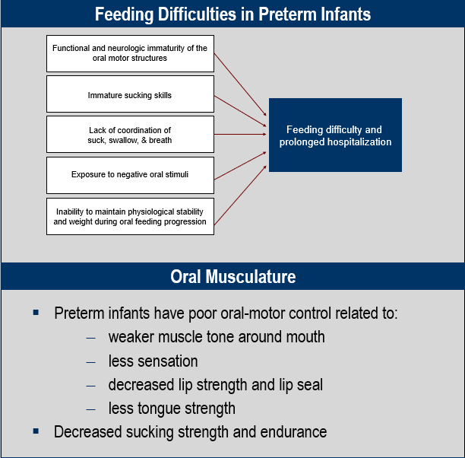

Slide 10
We need a safe, scientific, evidence-based solution….

Slide 11

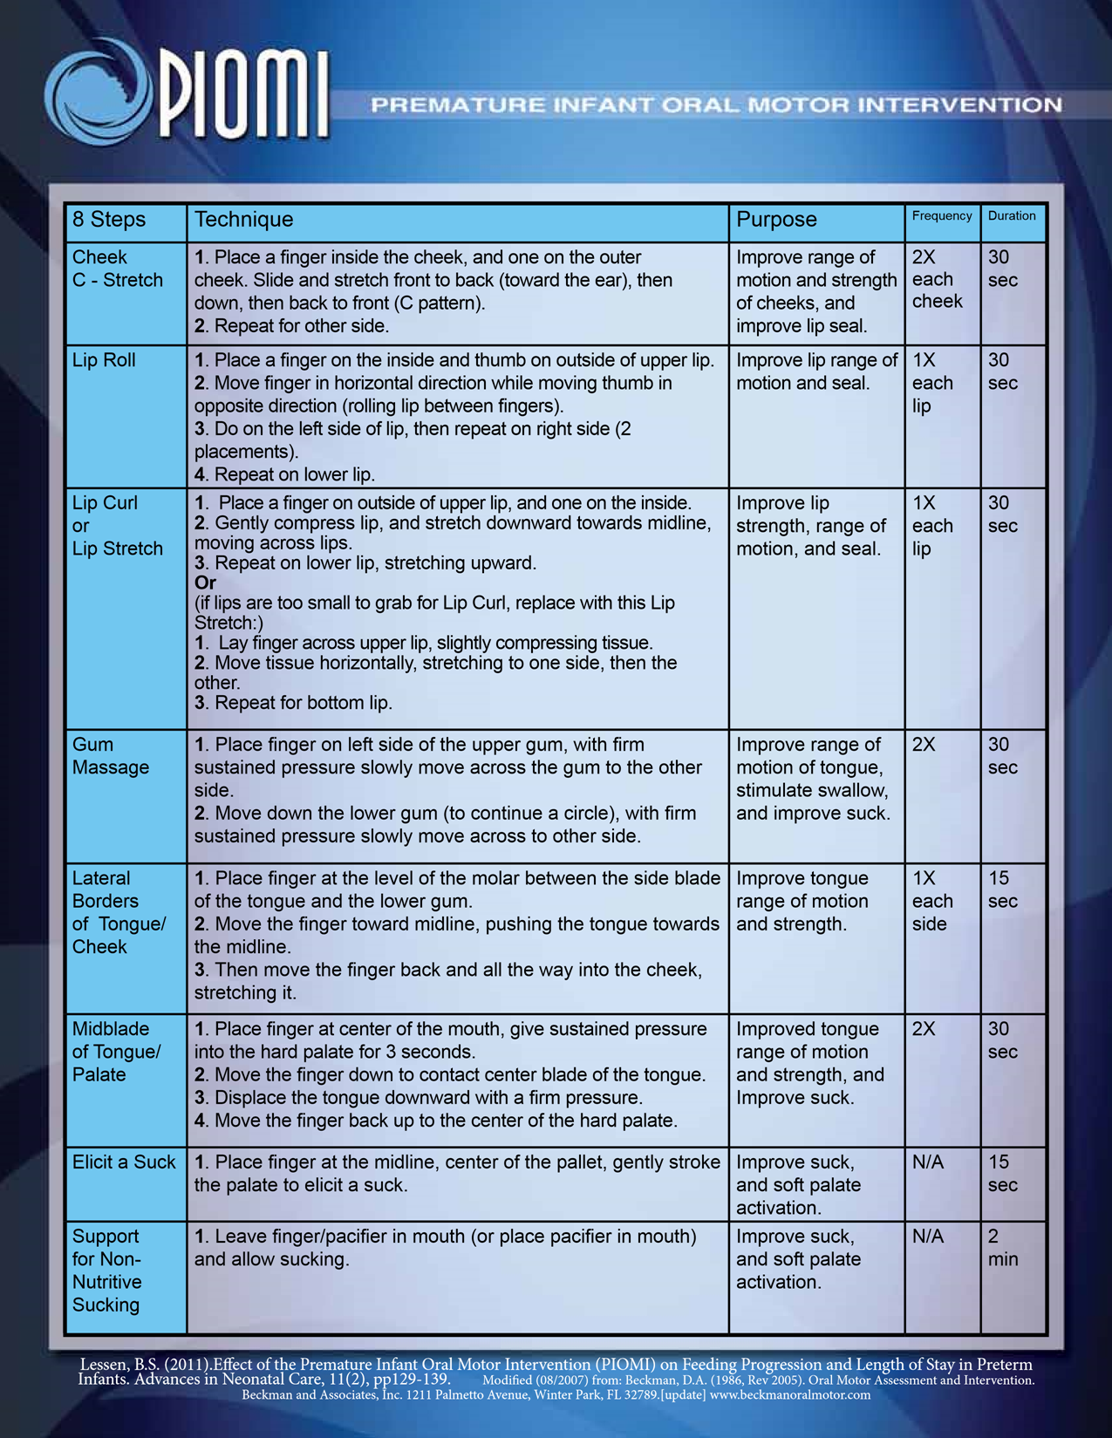
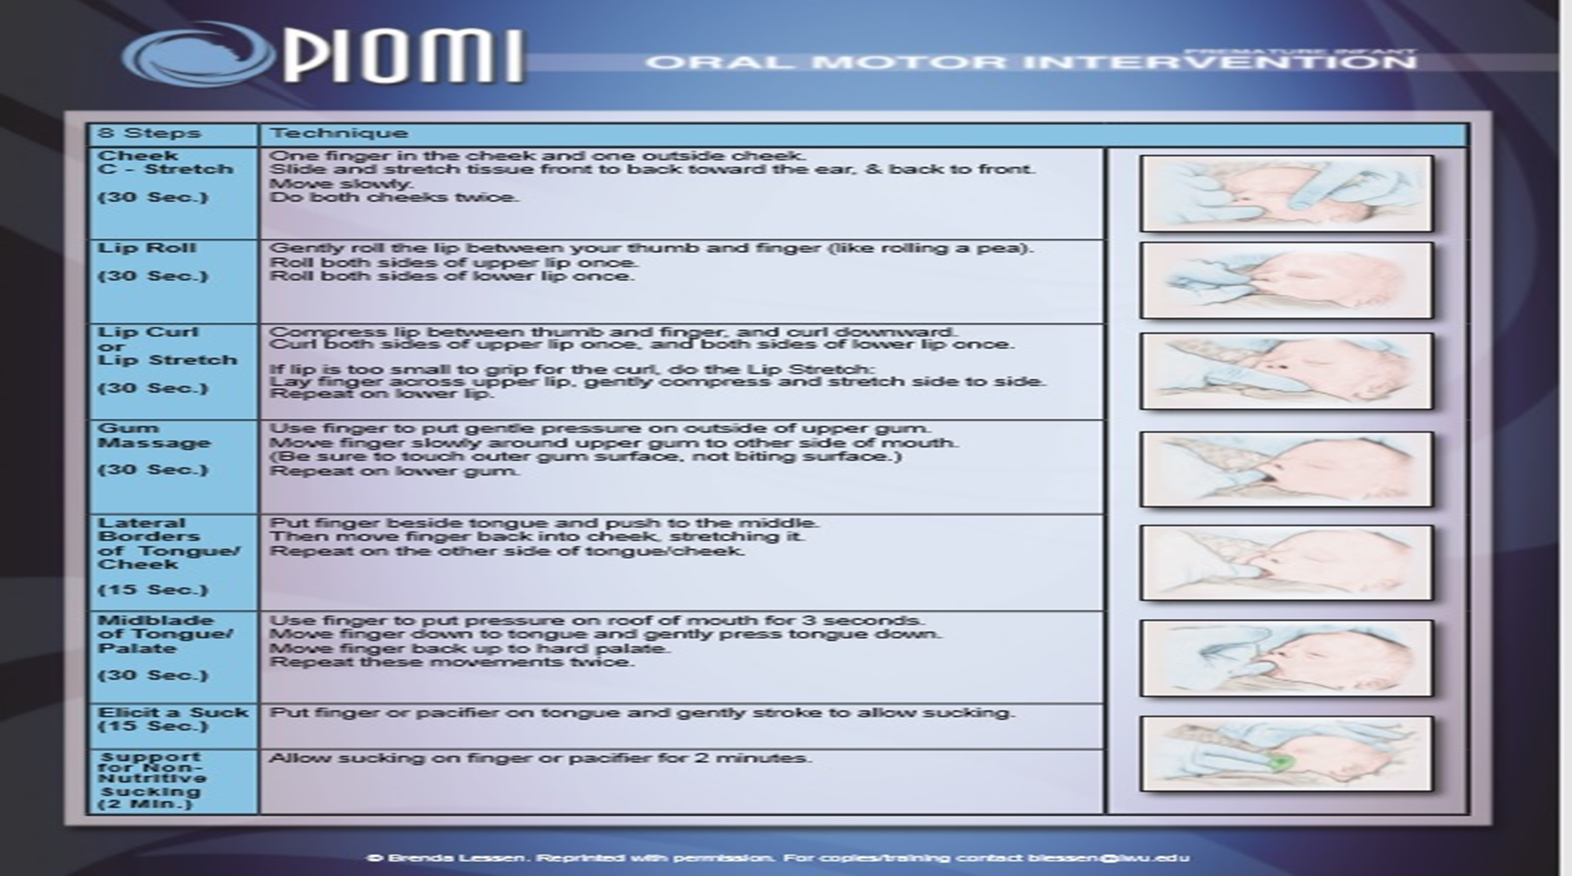
What is it?
Premature Infant Oral Motor Intervention
Purpose: to SIMULATE the in-utero oral motor experience that develops feeding skills.
Based on Beckman’s work (BOMI)
Made specific for preterm infants
5-minute oral motor intervention that provides assisted movement to activate muscle contraction and provides movement against resistance to build strength in premature infants.
The intervention increases functional response to pressure and control of movements for the lips, cheeks, jaw, and tongue.
Uses a pinky finger for all 8 steps

Slide 12
Intro to Systematic Review-Evidence
Oral feeding is a complex task for preterm infants and dependent upon maturation of CNS and influences from chemosensory and perioral tactile input. The functional and neurologic immaturity of the oral motor structures is evident in the poorly developed oral musculature, reduced sensation in the intraoral/perioral areas, lack of lip seal, and reduced tongue and cheek strength. Early oral motor therapy can be provided to activate sensation, improve muscle contractility, and increase oral motor organization. There is substantial international evidence supporting the positive effect of oral motor therapy on feeding maturation, resulting in significantly faster transitions to full oral feeding and thus shortening length of hospital stay. The PIOMI was developed specifically as an early pre-feeding intervention, to capitalize on the early neural networking opportunities in the preterm brain. The intervention has demonstrated strong intervention fidelity and provides a standardized approach to applying early therapy.
The purpose is to summarize the converging international evidence for PIOMI specifically, in order to develop an evidence-based protocol for its use in the NICU.

Slide 13
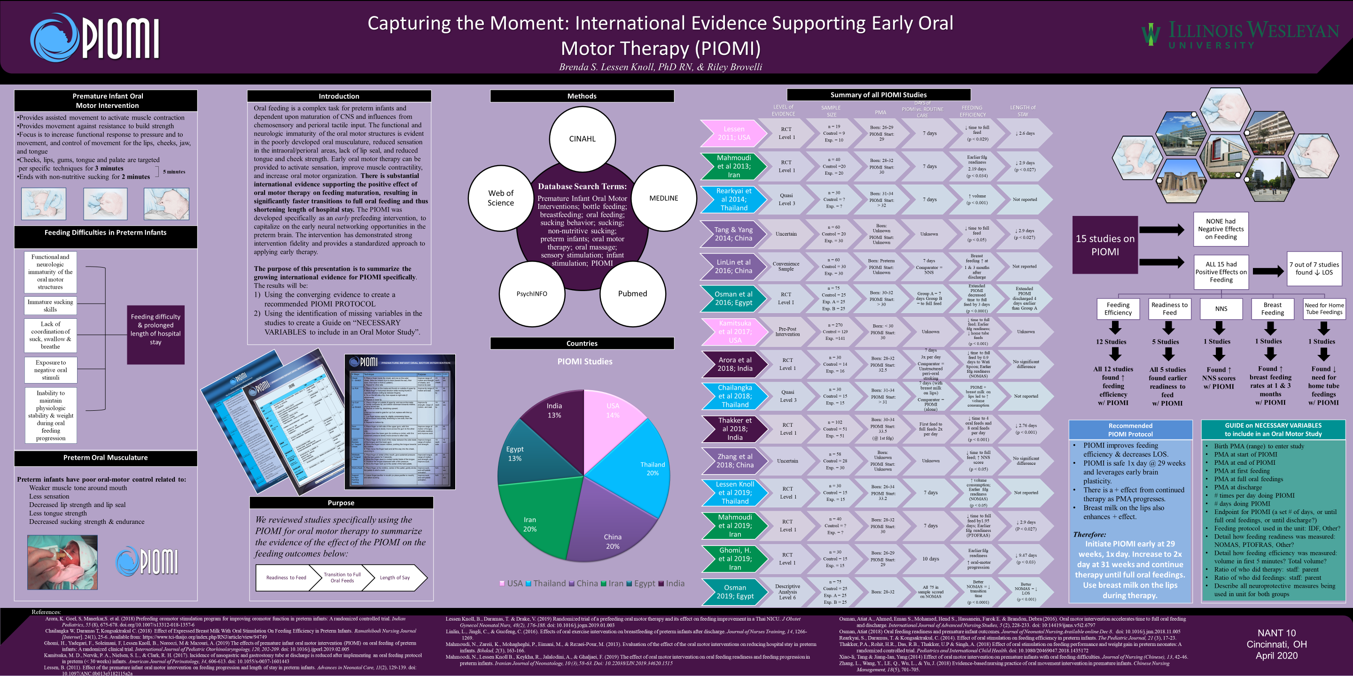

Slide 14
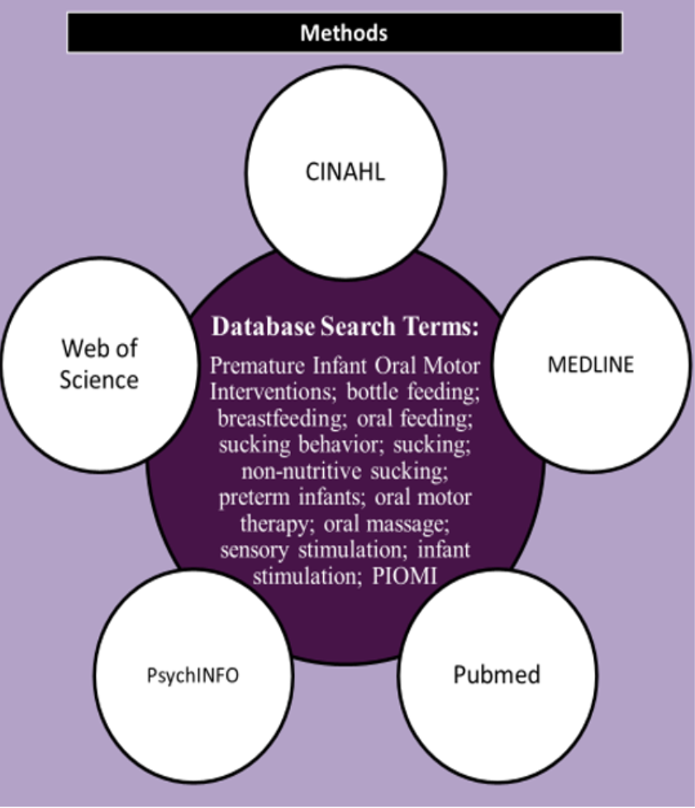
Methodology

Slide 15

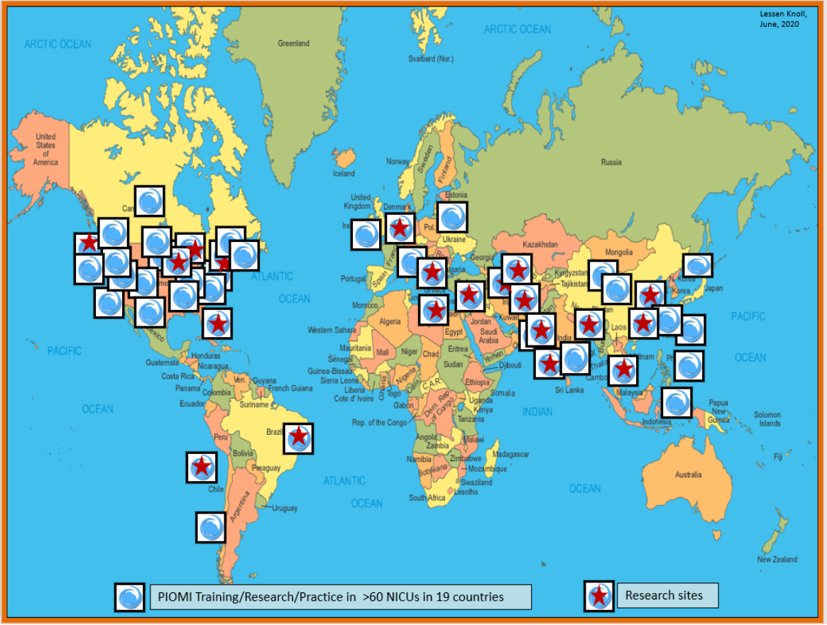
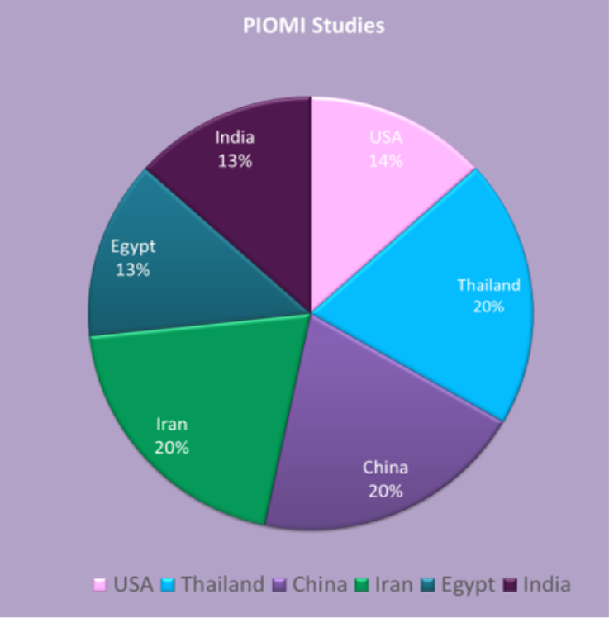
International Footprint

Slide 16
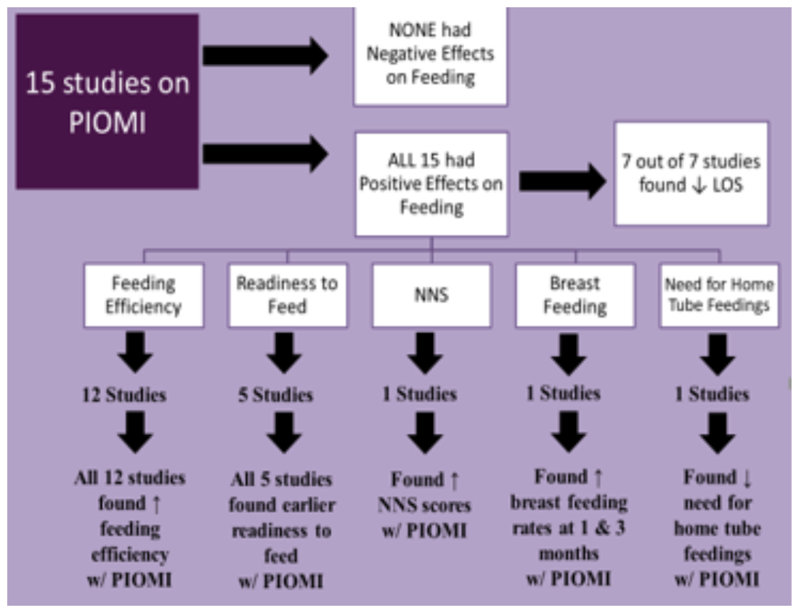
Results

Slide 17
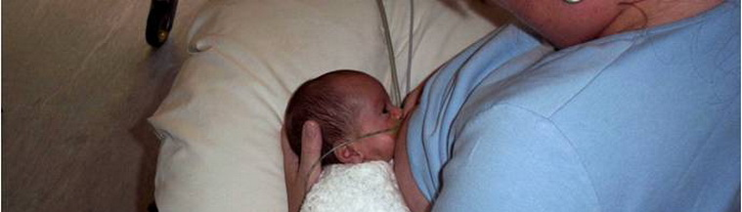

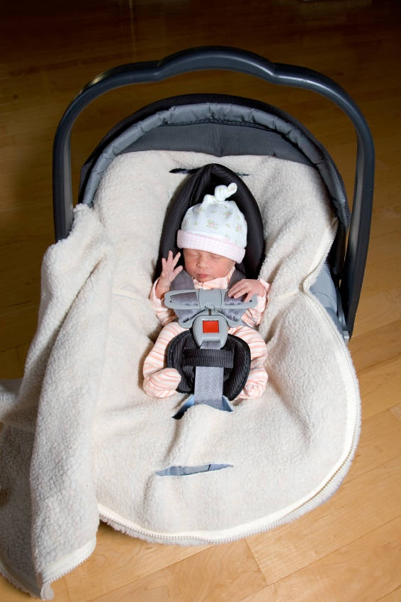
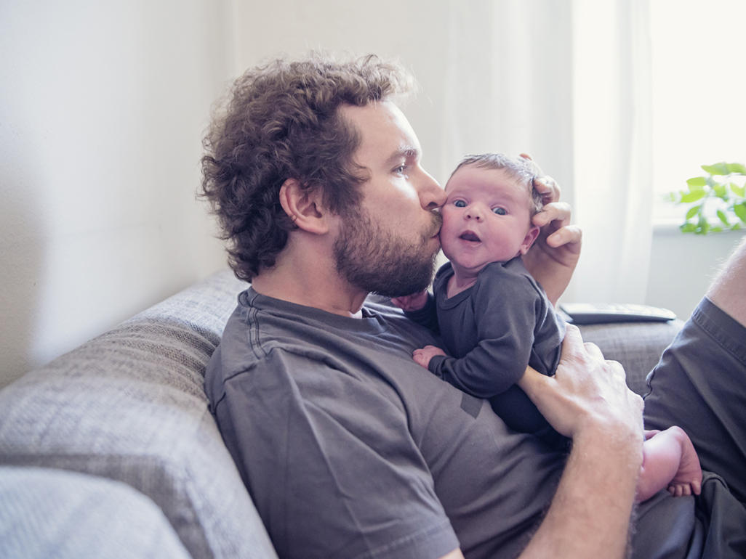
Global evidence shows that PIOMI results in….
​Earlier readiness to feed
Reduced transition time to full oral feedings
Improved suck strength
Increased mean Neonatal Oro-Motor Assessment Scale score
Improved Early Feeding Skills (EFS) Assessment
Improved Preterm Oral Feeding Readiness Assessment Scale (PTOFRAS)
Improved LATCH score
Increased direct breastfeeding rates at 1 month and 3 months after discharge from the NICU
Decreased length of hospital stay → Reduced cost

Slide 18
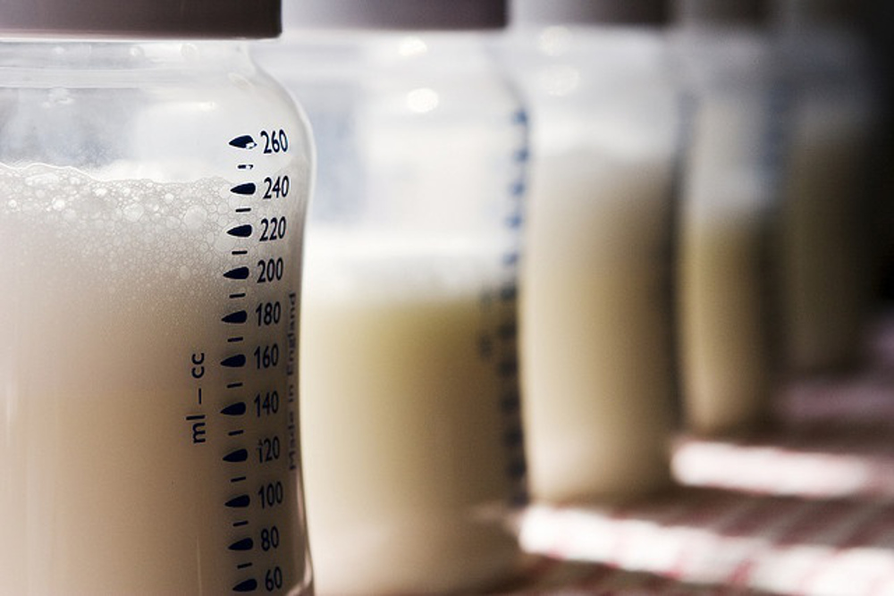
PIOMI and Breastmilk/Breastfeeding
During inpatient therapy:
Follow-up effect:
Expressed breastmilk on the lips during therapy:
Infants respond positively to the scent
Nice lubricant for dry lips
Evidence shows better bottlefeeding vs PIOMI alone
  Fdg efficiency higher on days 1, 3, and 5 when adding expressed breastmilk (Chailangka et al, 2018)
PIOMI led to higher rates of breastfeeding at both 1 and 3 months follow up after discharge vs NNS
Babies went home with a stronger suck
Better endurance
And a more positive experience that lends itself to continuing
  PIOMI vs NNS only (Linlin, et al, 2016, 2016)

Slide 19
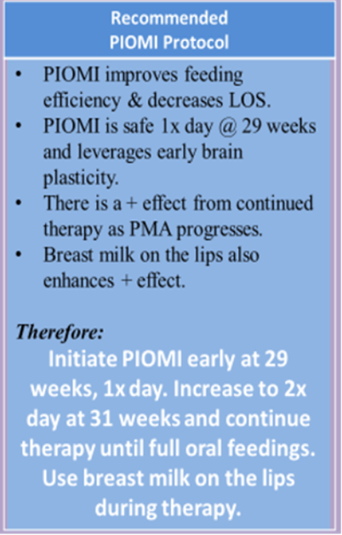
Evidence drives your protocol…
Timing
Frequency
Duration
Cluster care
15-30 minutes before a temp/diaper/feed
Brings to quiet alert state optimal for feeding
PRE-Feeding development
WHY EARLY = leverage brain plasticity
Safe to start at 29-30 weeks 1 x day
After 31 weeks can increase to 2 x day
Watch tolerance
Monitor cues
Minimum of 7 days
Studies have done 7, 10, 14, and…
Continued to d/c
Exponential IMPROVEMENT across days of therapy
Others continue at home: Easter Seals Follow-up

Slide 20
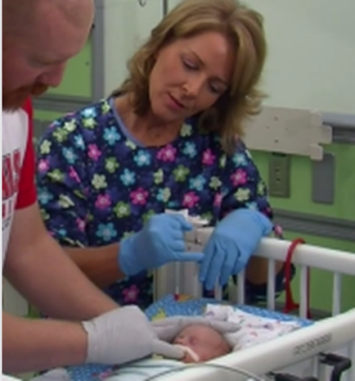
Providing a PIOMI session…
Consult with bedside RN on physiological stability before therapy
Keep infant on continuous monitoring during therapy
Plan for 15-30 minutes before a care/(tube)feeding time
Wash hands
Don gloves (if required at your agency)
Position properly (midline, slightly flexed, slight chin tuck)
Provide PIOMI for 5 mins (3 mins of stroking steps followed by 2 mins of NNS)
Stop therapy if any cues of intolerance (behavioral cues OR on the monitor – HR drop, apnea, desaturation) and notify bedside RN
Notify bedside RN when completed
Collaborate with RN on documentation (separate EPIC tab is ideal)

Slide 21
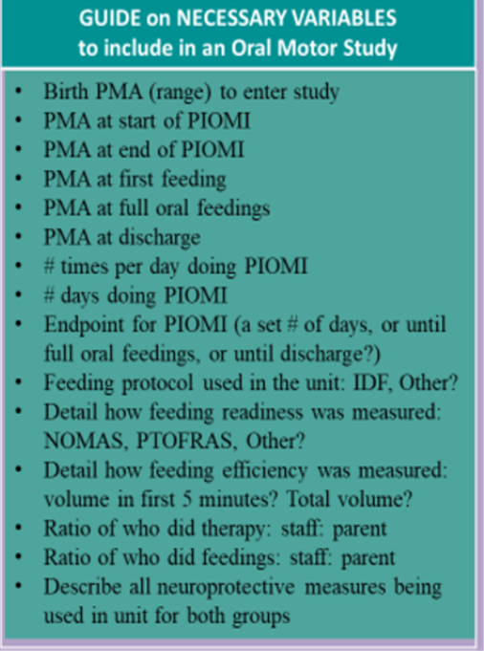

Documentation for PIOMI
Quality Improvement/Data Collection
Variables needed for future study of effects:
PMA at start of PIOMI
PMA at end of PIOMI
PMA at start of first oral feeding
PMA at time of full oral feeding
Who did the feeding?
What was fed? Formula or breastmilk
How was it fed? Bottle, breast, spoon…

Slide 22
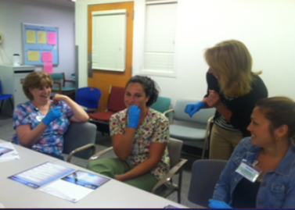
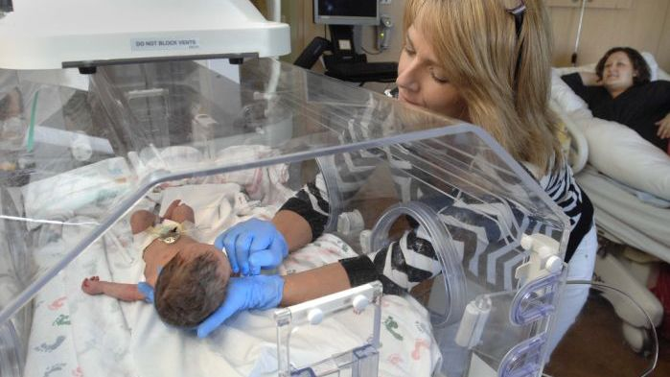
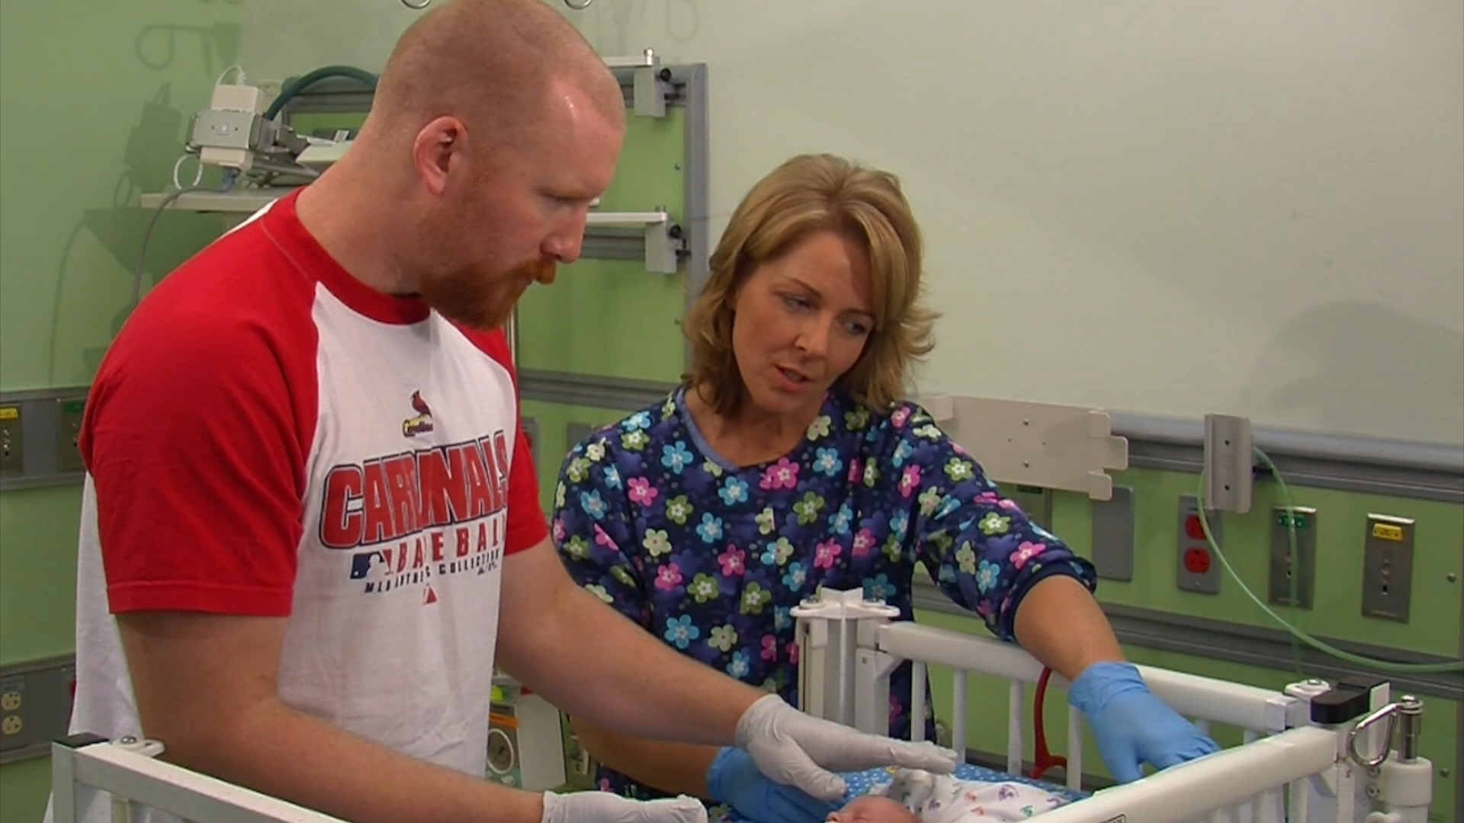
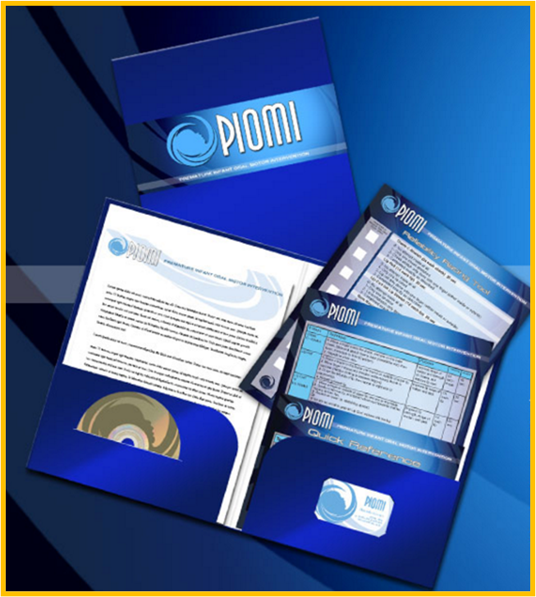
PIOMI Training:
Training Bundle for purchase on PIOMI.com
12-minute demonstration video with built in guided practice time
Downloadable & Streaming Capable
Multiple languages
Special Parent Version of Tool
also
On-Site Competency-Based Training Options
Virtual Webinar Training

Slide 23
PIOMI Tool for Professionals
Includes:
Detailed description of the technique for each step
The purpose of each step
The frequency of each step
The time each step should take

Slide 24
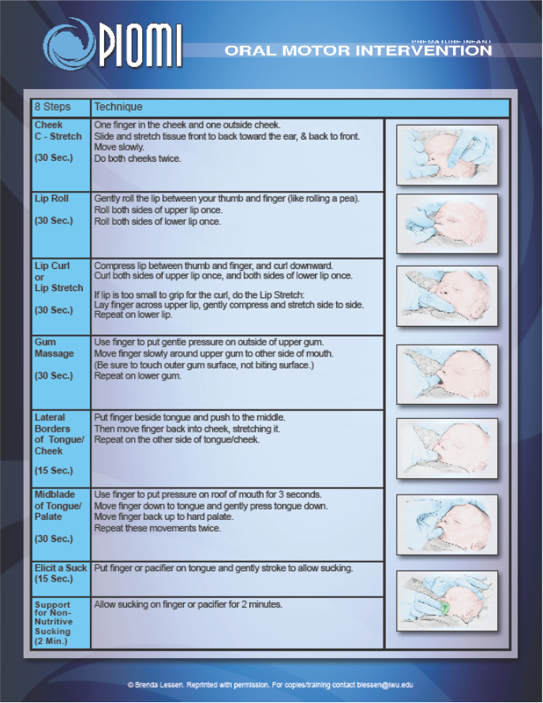
Parent Version of PIOMI Tool
Includes:
Simplified descriptions of technique for each step
Graphic picture showing each step

Slide 25
Quick Reference Guide
½ page size card to place on infant’s bed area as a reference for staff and/or parents who are providing PIOMI
Also makes it easier to identify which infants are getting PIOMI with this on the bed area
Comes as an ID badge size to wear as a reference

Slide 26
Reliability Rating Tool
Used for the Intervention Fidelity Study (2015)
Measured inter-user, intra-user, and repeated performance reliabilities
Also can be used for training and re-training

Slide 27
PIOMI Demonstration Video
For purchase on PIOMI.com

Slide 28
Practice Session
Have PIOMI tool in front of you
Use Quick Reference Guide
Glove if you prefer
Perform each step on self
TIME each step

Slide 29
Development of Unit Protocols
Interdisciplinary Roles
  Training for PIOMI (Key Players)
    Medical/Nursing/Therapy
    Manager
    Educator
    IT
Applying PIOMI Therapist - Experts
  RN
  Parents
  Child Development Specialists
  Lactation Consultants
  Neonatologists/NNPs
Timing, Frequency, & Duration
Documentation needs
Data collection needs: QI/RCT

Slide 30
Resources on www.PIOMI.com
Background on PIOMI
Abbreviated Demonstration video
Research & Evidence
All known publications with links
All conference presentations with links
Training Options
Testimonials
PIOMI for Purchase
Live Chat consultation with Dr Lessen Knoll
Go to PIOMI.com for training program information or contact me at blessen@iwu.edu

Slide 31
What to find on PIOMI Facebook
PIOMI Premature Infant Oral Motor Intervention
@pretermoralmotor
https://www.facebook.com/PIOMI
Updates on:
Presentations
Events
New scholarship
Publications
Networking

Slide 32
Discussion/Q&A

Slide 33

Dr. Brenda Lessen Knoll
Author/Founder of the
Premature Infant Oral Motor Intervention (PIOMI)
Associate Professor of Nursing
Illinois Wesleyan University
Bloomington, IL blessen@iwu.edu www.piomi.com
BSN 1989 Illinois Wesleyan University, Nursing
MS 1995 University of Illinois at Chicago , Community Health Nursing/Maternal Child
PhD 2008 University of Illinois at Chicago, Neonatal Nursing Science
PIOMI 2011
Full CV at www.piomi.com

Slide 34
